Slide 1
Running head: Nespresso distribution strategies
Students name
Institution name
Instructors name
Course title
Date

Slide 2
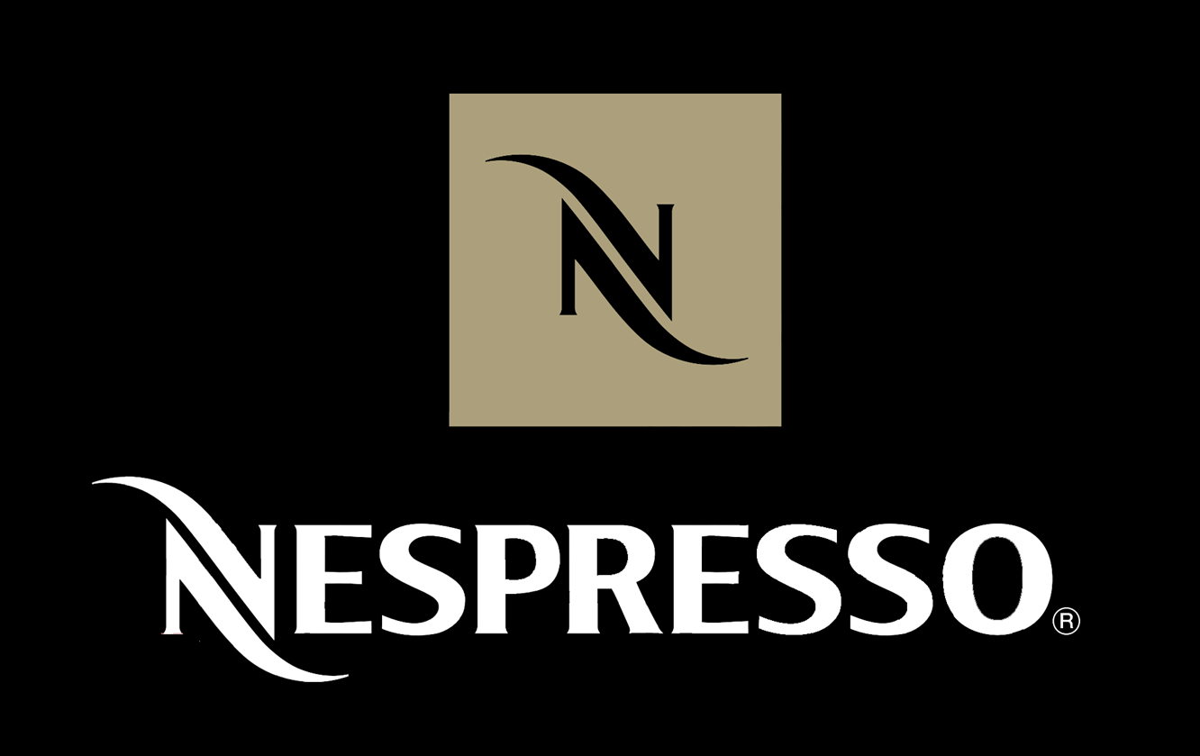

Slide 3
SUMMARY
The history
Marketing strategy
Marketing operations
What next

Slide 4
Introduction
The history of Nespresso
It is part of the group known as the Nestle that is located in Switzerland
Capsules and machines
They have their market all over the world
It is a well known company by many people all over the world
Nespresso is the world's leading high- class coffee producers (Brem, 2016).
Coffee specialists are available 24/7
The company has offices in the main towns such as Miami and Paris.
Nespresso has recorded the highest sales among all Nestle SA's subsidiaries

Slide 5
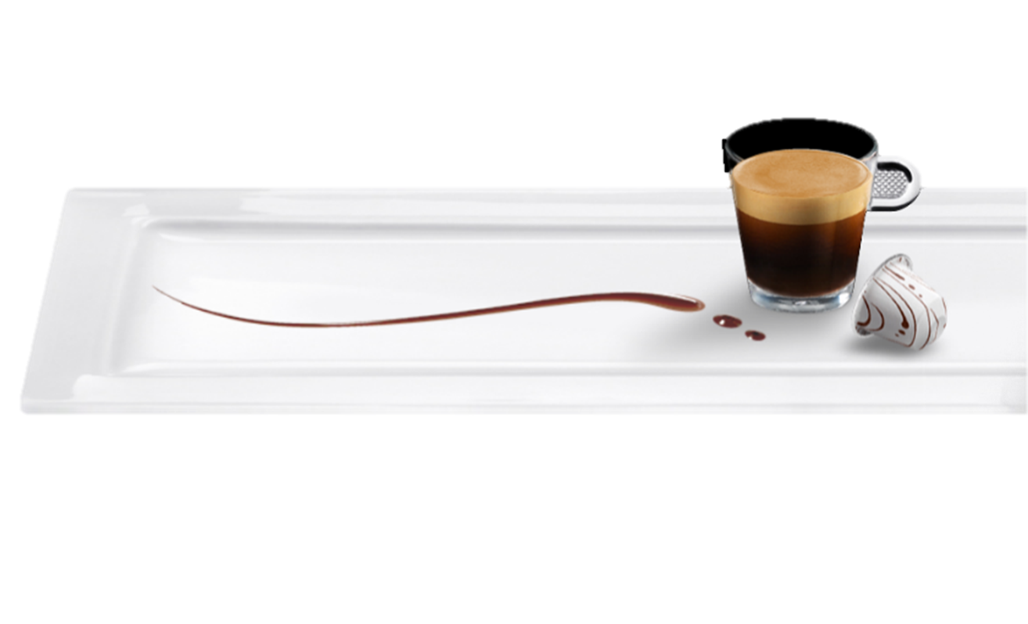
Invention history
Come into existence in 1976 and it was invented by a man known as Eric Favre
This was unsuccessful
It was later brought into existence in the year 1988 by Jean- Paul Gaillard and this time the market was a success.
It grew up over the years and some contracts were signed by different manufacturers

Slide 6
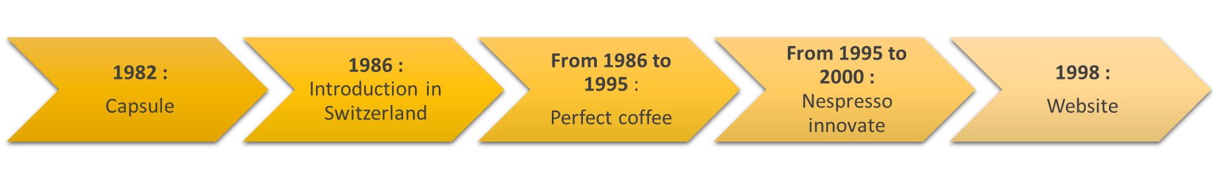
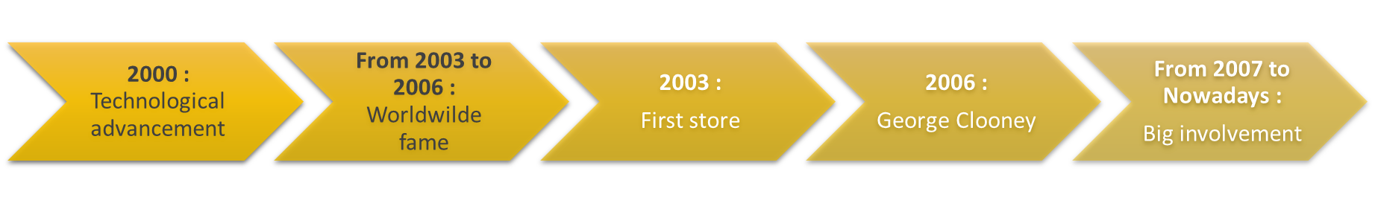
Timeline

Slide 7
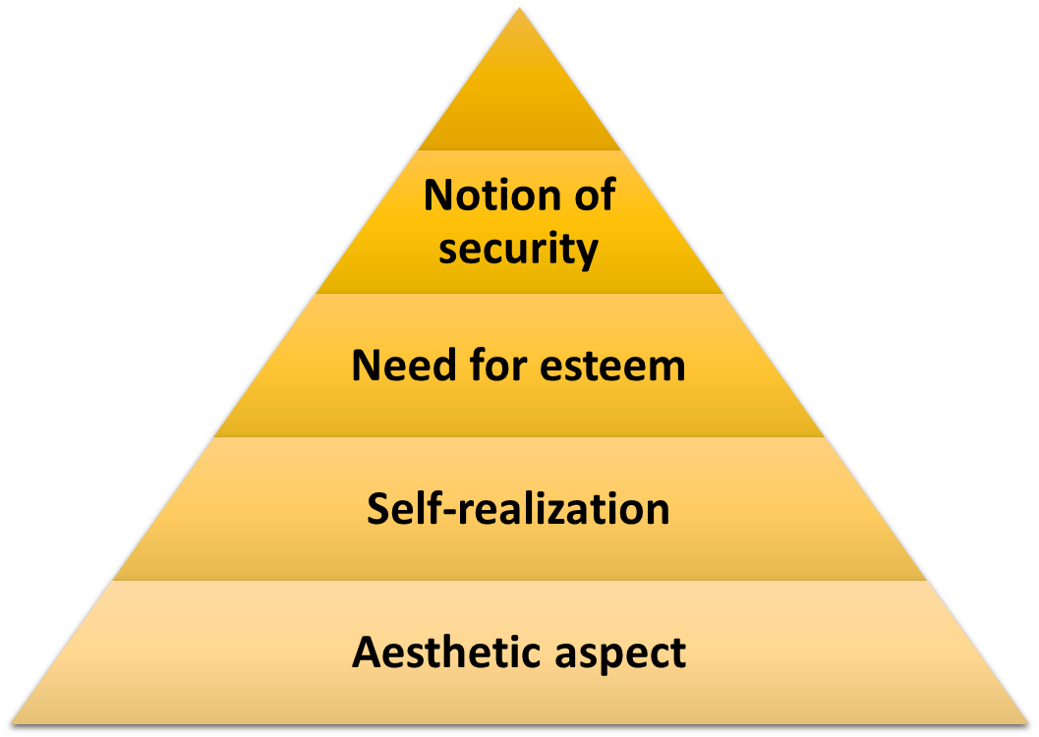
MARKETING STRATEGY
Customers needs; Maslow’s Pyramid
Analysis of the environment

Slide 8
Analysis of the logo
White – coffee foam color, the white color is mainly taken to be a color of purity
Brown – coffee color which is considered a color that is prestigious
N stands for the Nespresso
CLOSED CHANNEL STRUCTURE FOR NESPRESSO
The fact that Nespresso has a closed channel structure means that it won't be possible for any other people to do the distribution of coffee pods except for Nespresso(Matzler and Kurt, 2013).
This limit of coffee pods distributors makes Nespresso a monopoly and hence competitors who would like to join the business of making coffee pods find it hard to join because Nespresso has already dominated the market by being the only producers of the coffee machine.

Slide 9
Target analysis
Secondary target- This are mainly the customers of the products who have less demand and they are not frequent buyers. Sometimes they have less cash for the purchase of their products and also their demand of the product is fewer
Main target- there demand for the products are mainly higher and they are considered to boost the business in the purchase of the products.
Core target- mainly those customers who are there to purchase the core products of the company.

Slide 10
Segmentation
Allows differentiation
Different ways of segmentation
POSITIONING
Original idea : build loyalty
Moreover, Nespresso has patent rights and hence is the only manufacturer and distributor of coffee machines and coffee pods in the whole world. The patent protects Nespresso from competitive forces.

Slide 11
SWOT ANALYSIS
STRENGTHS
Patented capsules
Market Leader
Good brand image
Compulsory purchase of capsules
Loyalty
Luxurious shops
Personalized service
Recycling capsules

Slide 12
SWOT ANALYSIS
WEAKNESSES
High prices
Difficulty for the public to enter the circle
Shops only in a few large cities
Misuse of the patent
Single use of the machine

Slide 13
SWOT ANALYSIS
OPPORTUNITIES
Increased demand for high-quality coffee.
Adverse weather conditions leading to high demand during winter.
Growth market
Many different flavors

Slide 14
SWOT ANALYSIS
THREATS
Appearance of capsules "L’Or" from Maison du Café and Casino
Limited term patents
Multi-purpose devices entering the market
Cheaper products from competitors.
Lack of indirect distribution channels (Elder 88).

Slide 15
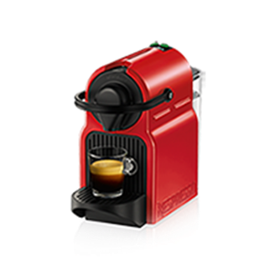
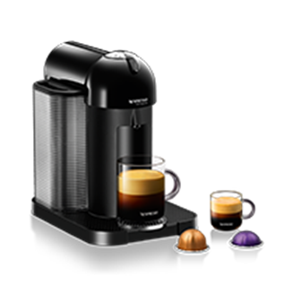
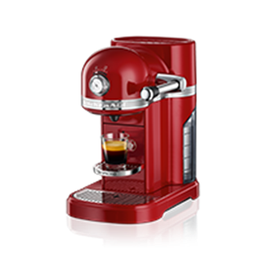
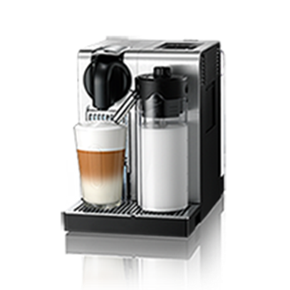




Market operations
PRODUCTS; Coffee makers : esthetism and quality

Slide 16
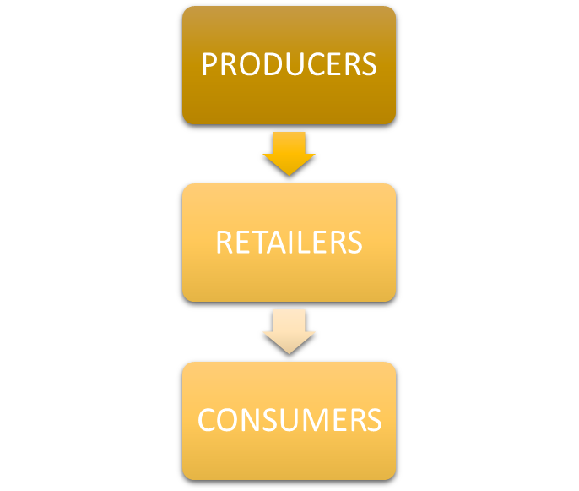
SELF DISTRIBUTION STRATEGY
Nespresso holds its own shops.
Direct system
Benefits:
Reducing costs
Increase launch Speed
Disadvantages:
Market growth limitations
Heavy investments

Slide 17
ADVERTISING / PROMOTION
Advertising (Promotion) :
Creation of the logo : Future Brand agency
Graphic identity : sober colors
"N": brand recognition sign
The base-line "Nespresso, what else? »
Advertising Campaigns
George Clooney and Jean Dujardin : emblematic characters of the brand
They embody the values of NESPRESSO
Create the event without bore the consumer : surprising him without disappoint him

Slide 18

WHAT NEXT
Nespresso has become very successful in the recent years and it is estimated that in 12 years it has become one of the successful global beverage and food brands in most parts of the world.
How to keep their actual
market place in the future?
How will they contemplate
the future of coffee experiences?

Slide 19
Strategy Statement
To make the distribution of coffee machines and coffee pods efficient through ensuring controlled distribution structures. Ensuring that competitors are kept off so that they don't bring down the business by enforcing the patent rights (Metzler, 2013). Distributing high-quality coffee machines that do not break down easily and making sure that the coffee produced is of high quality also.

Slide 20
References
Brem, Alexander, Maximilian Maier, and Christine Wimschneider, (2016). "Competitive advantage through innovation: the case of Nespresso." European Journal of Innovation Management.
Elder, Sara D., Jane Lister, and Peter Dauvergne, (2014). "Big retail and sustainable coffee: A new development studies research agenda." Progress in Development Studies.
Matzler, Kurt, et al. (2013). "Business model innovation: coffee triumphs for Nespresso." Journal of Business Strategy.

Slide 21


